Slide 1
GIS: a very basic introduction
By Vanessa Casillas (Graduate Fellow)

Slide 2
Agenda
Overview of ArcGIS online
What is GIS?
Classic ArcGIS online overview
Layers
Edits
Send to New ArcGIS Online
Print and Share
Endnotes

Slide 3
Goal
Goal
Navigate ArcGIS Online
Make a simple map
Show your map your group or organization
Make a PDF print for presentations and reports

Slide 4
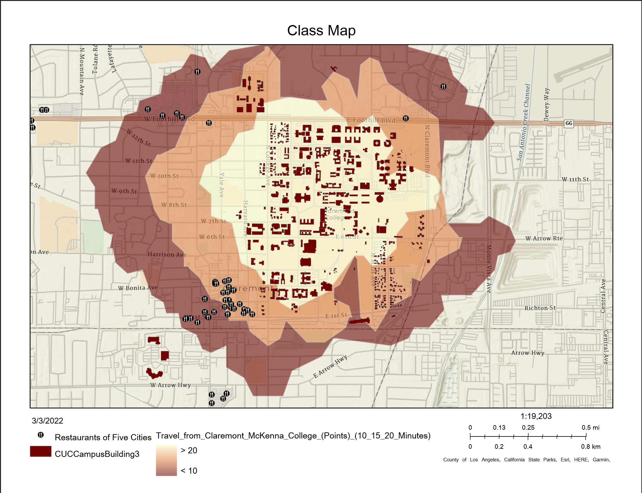

Slide 5
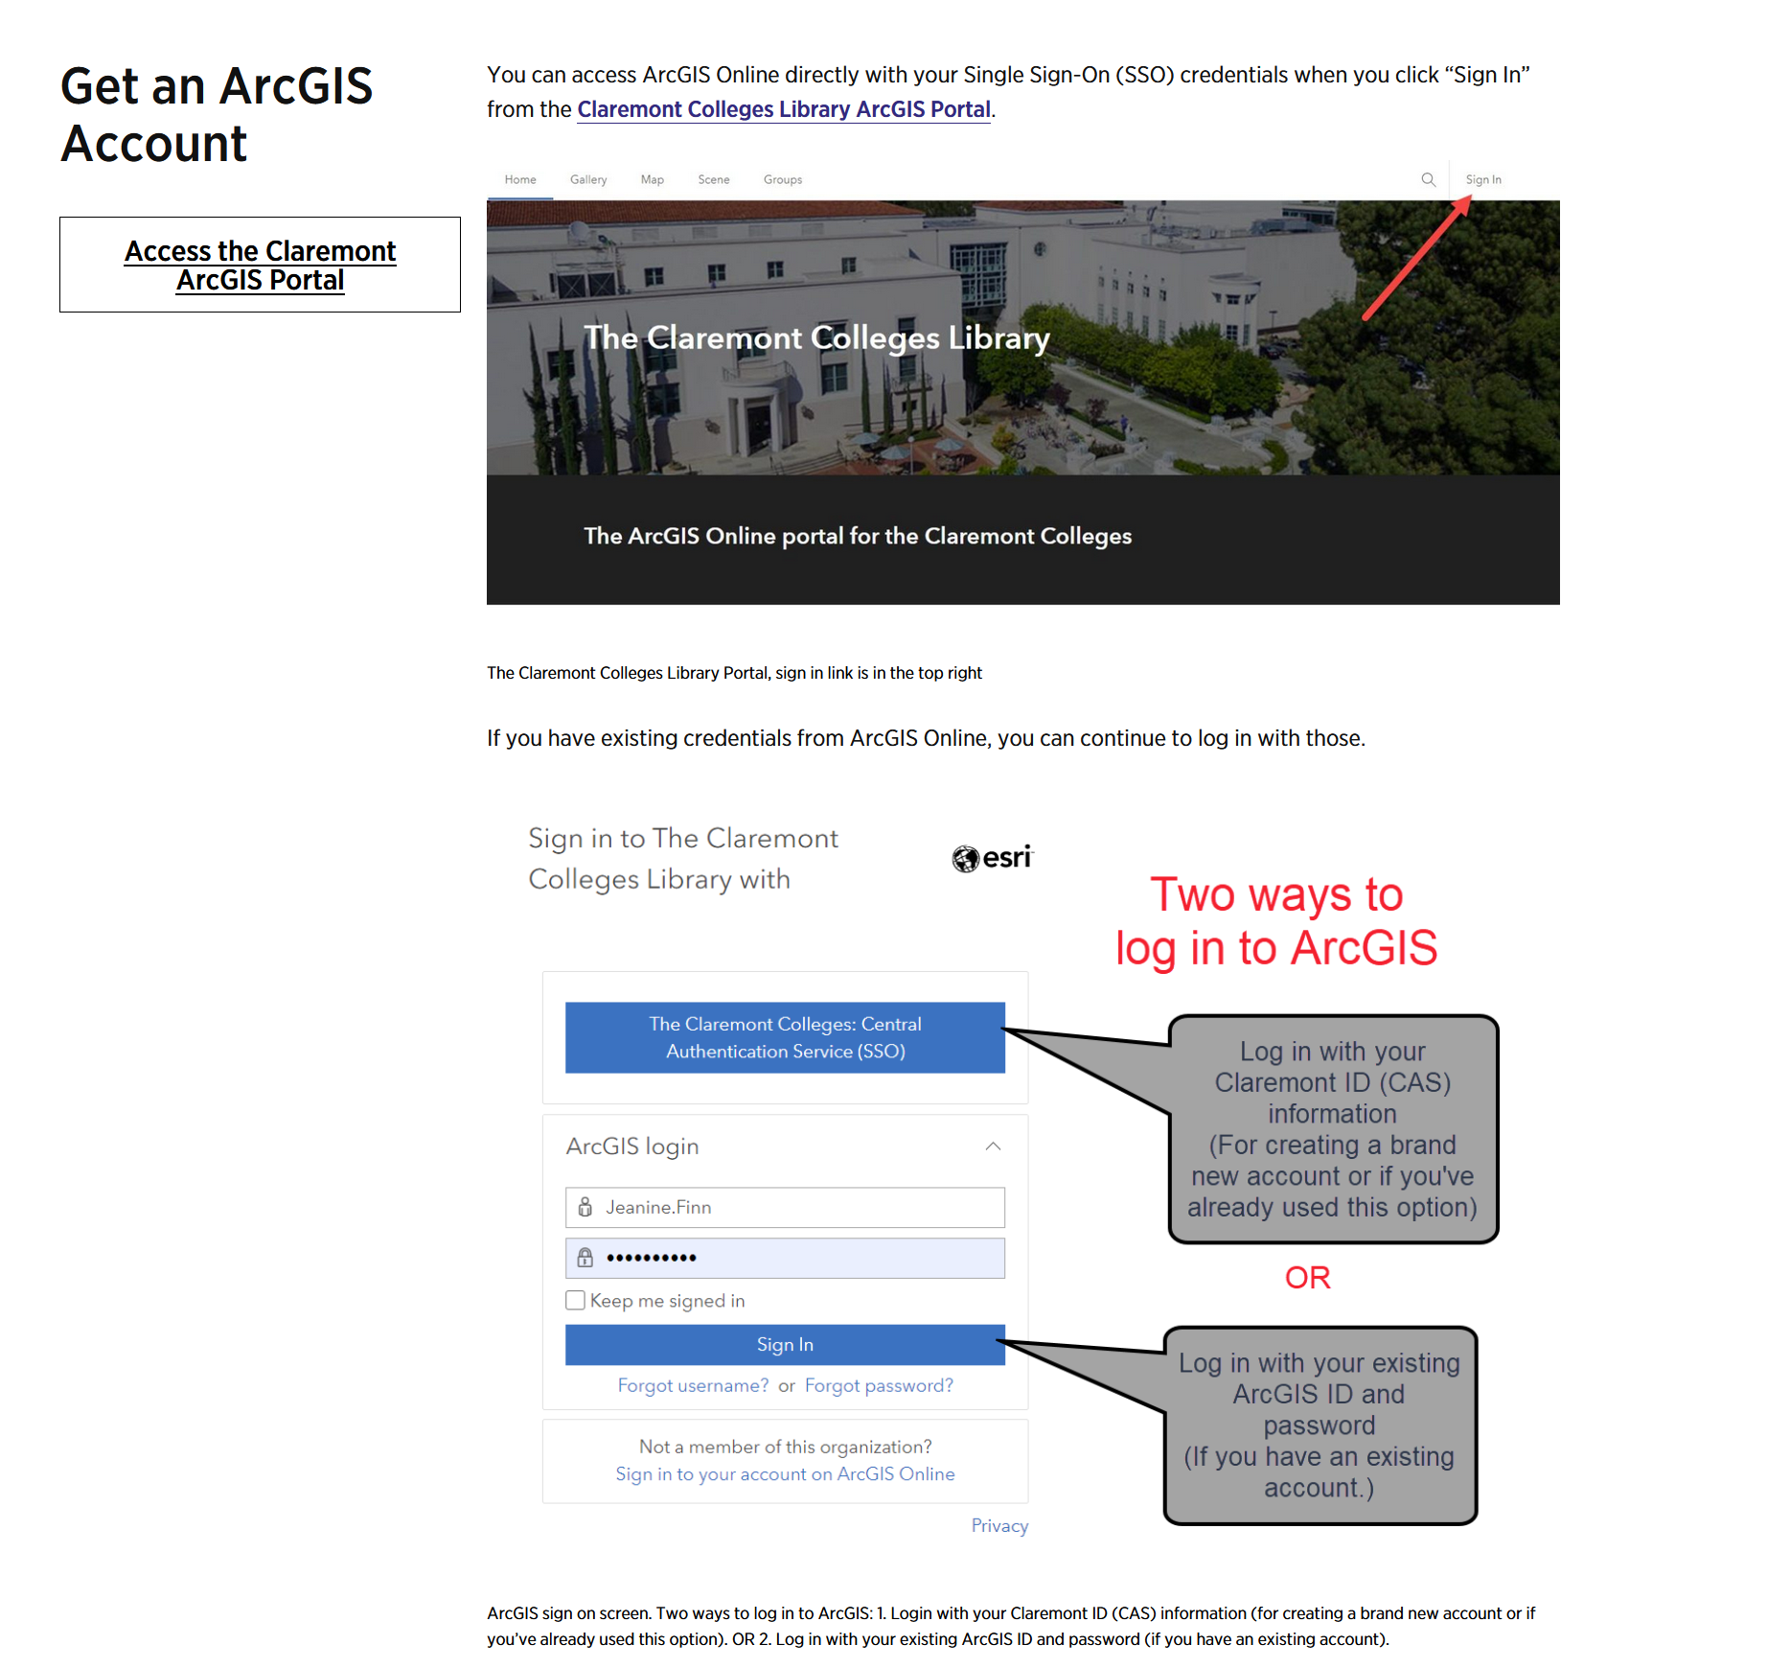
CMC – ArcGIS

Slide 6
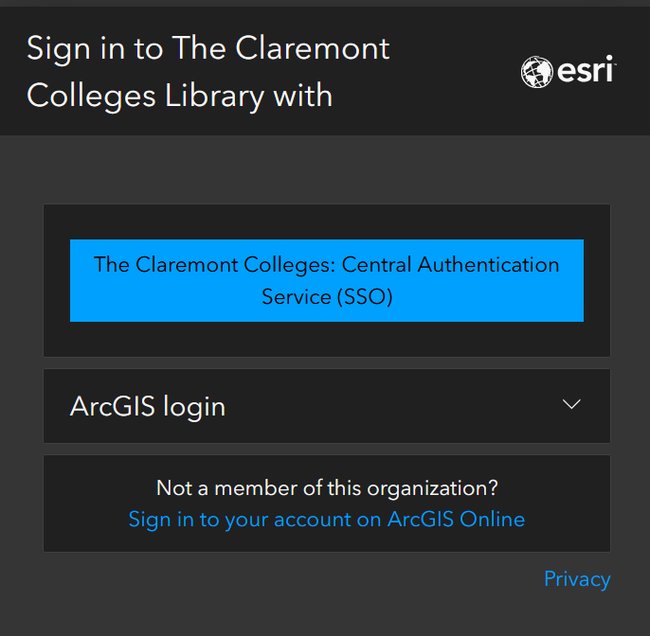
Organization and login

Slide 7
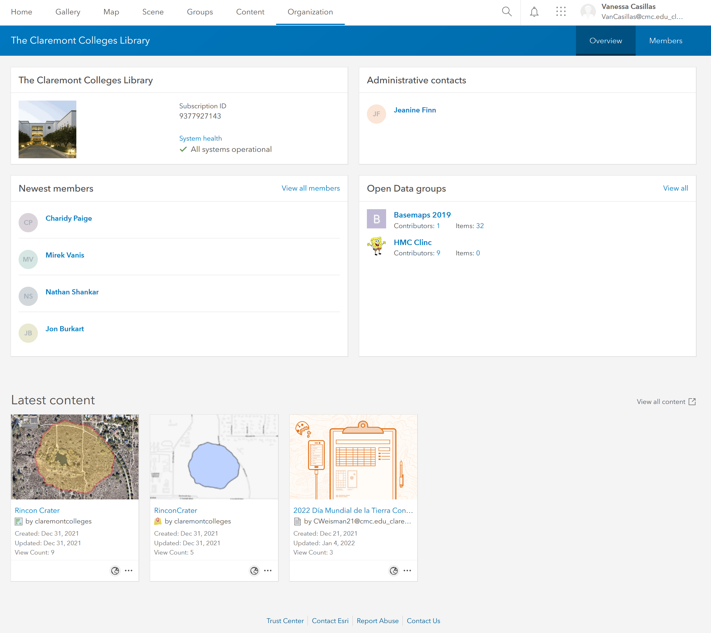
Home view

Slide 8
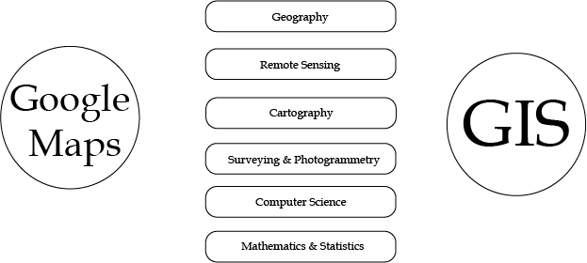
First Question people think of when learning GIS: GOOGLE MAPS – Is it GIS?
https://www.quora.com/Is-Google-Maps-considered-a-geographic-information-system

Slide 9
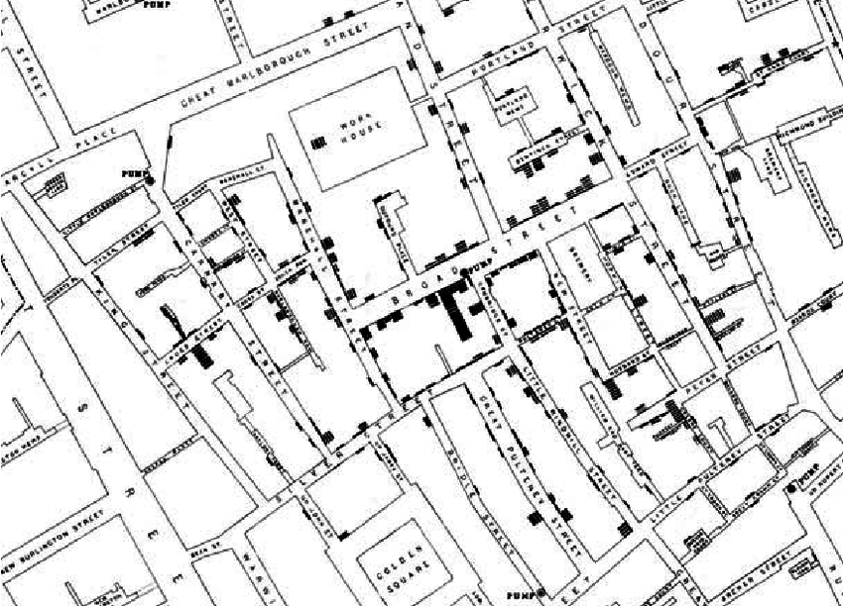
GIS? Quick Overview
GIS: Geographic Information Systems
Storing, retrieving, comparing spatial data
ESRI: Environmental Science Research Institute (The Science of Where)
Jack Dangermond Redlands
1854 Cholera Epidemic – London: Dr. John Snow
Mapped cholera deaths
Determined water pump source
https://www.researchgate.net/figure/John-Snows-famous-map-of-the-1854-Broad-Street-epidemic-attempted-to-positively_fig1_220144184

Slide 10
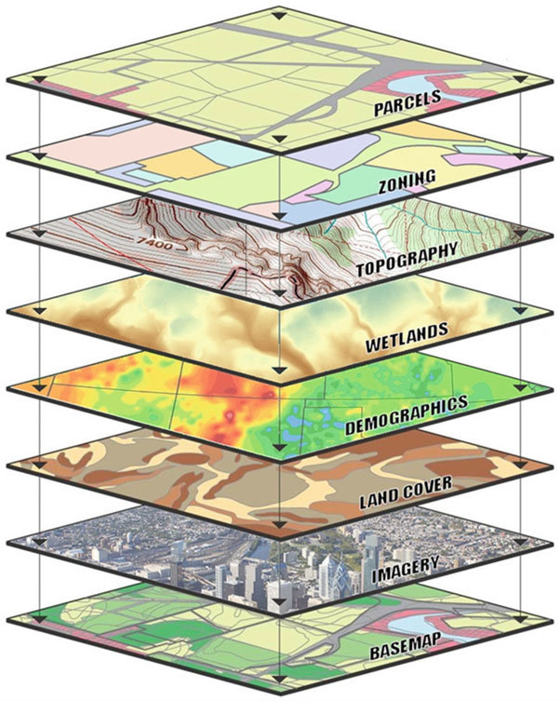
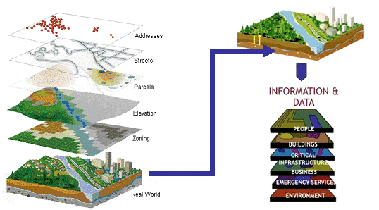
Layers and Layers and Layers
Shukla, Yogita. (2012). Innovative Geospatial Solutions - Key to India's Transport Infrastrcuture.
Kolios, Stavros & Vorobev, Andrei & Vorobeva, Gulnara & Stylios, Chrysostomos. (2017). WebGIS Applications for Weather, Marine, and Atmospheric Environments. 10.1007/978-3-319-53086-4_2.

Slide 11

Planning a Map: a simple map
Problem – why are we making a map?
Data – what layers do we need?
Analysis – what layers do we need to adjust or make?
Edits – who is looking at the map?
Results – does it tell a visual story?

Slide 12

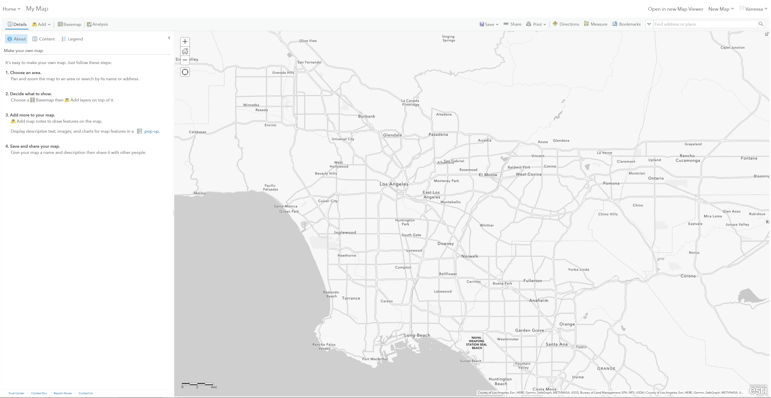
Classic ArcGIS

Slide 13
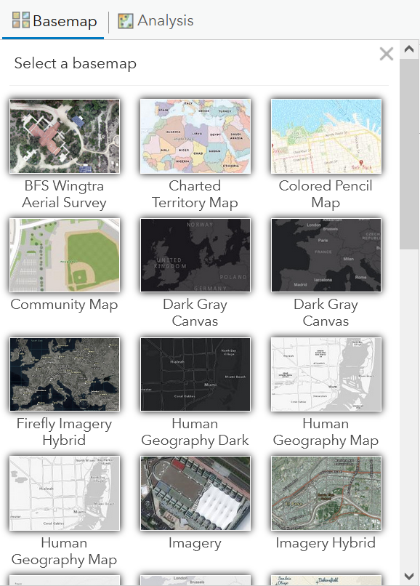
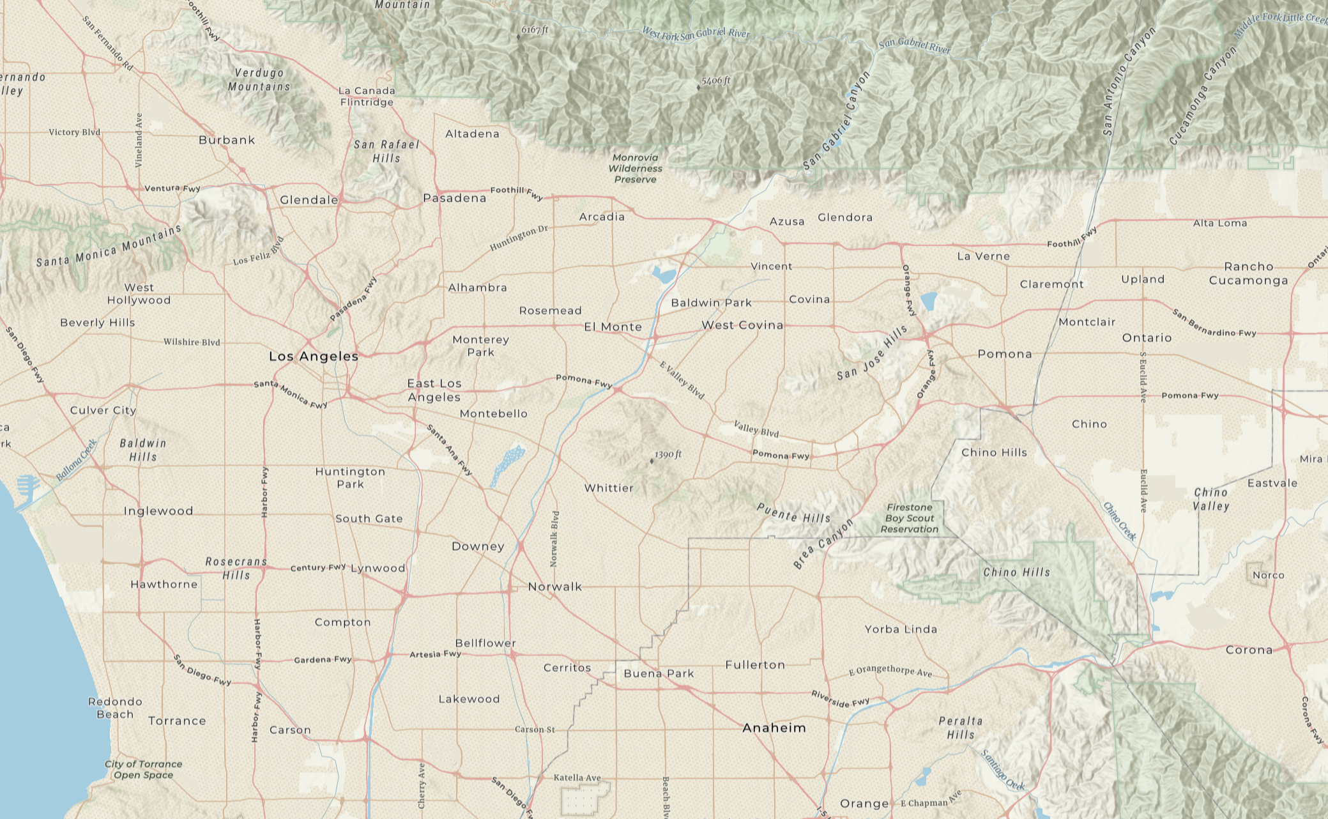
Base Maps

Slide 14
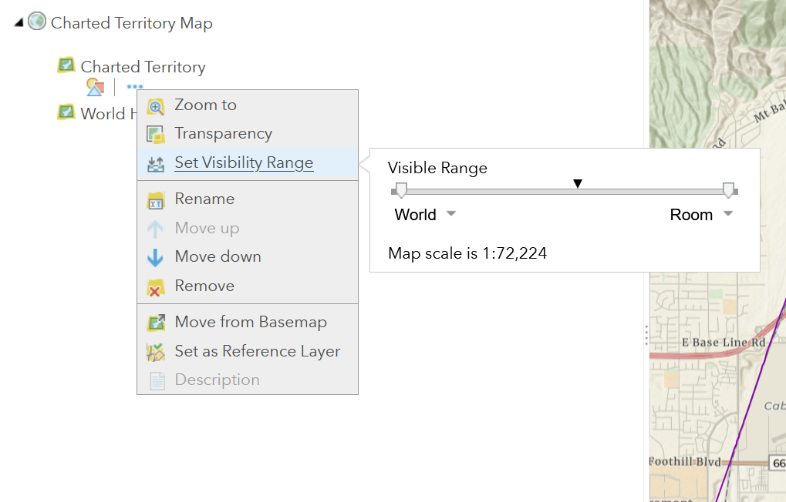
Base map
Overview

Slide 15
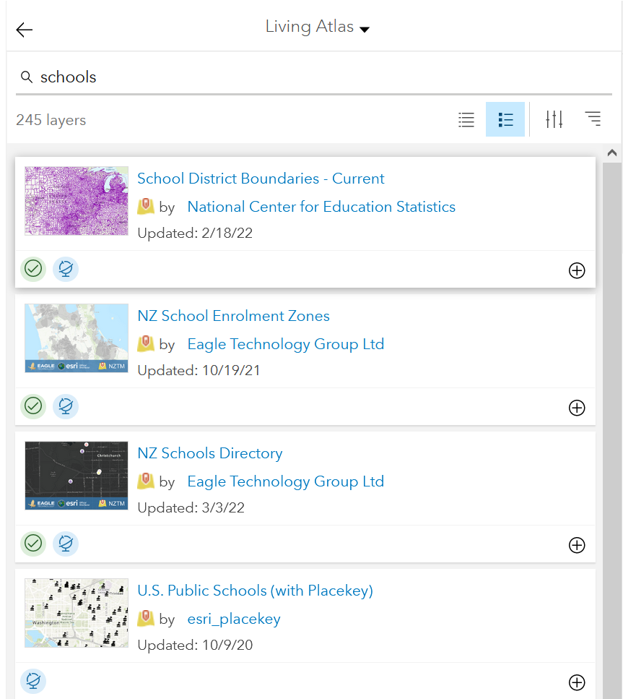
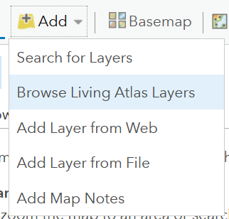
Living Atlas
Layers and layers and layers

Slide 16
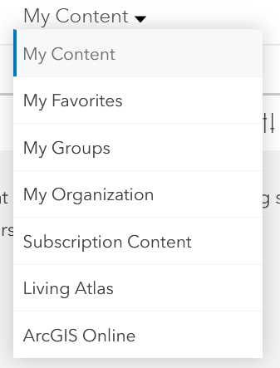
My Content

Slide 17
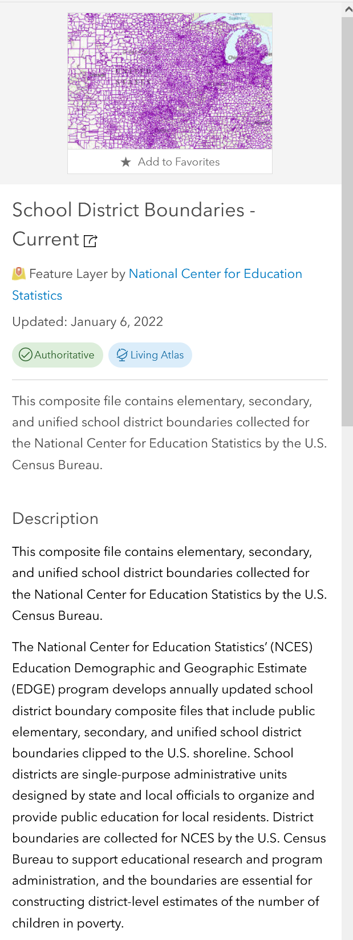
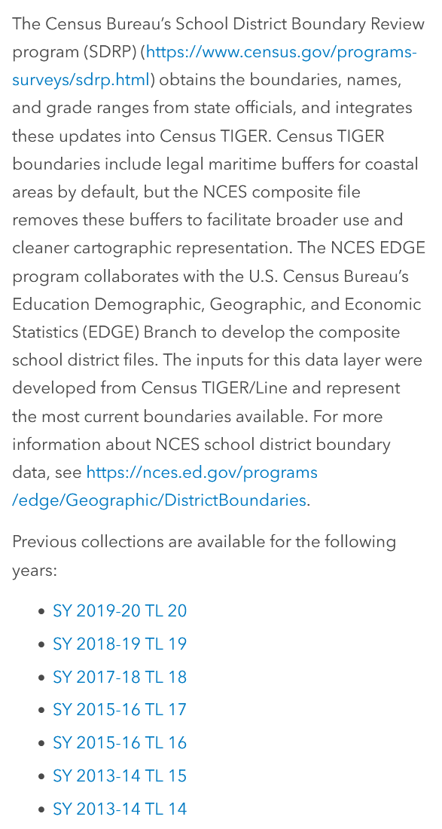
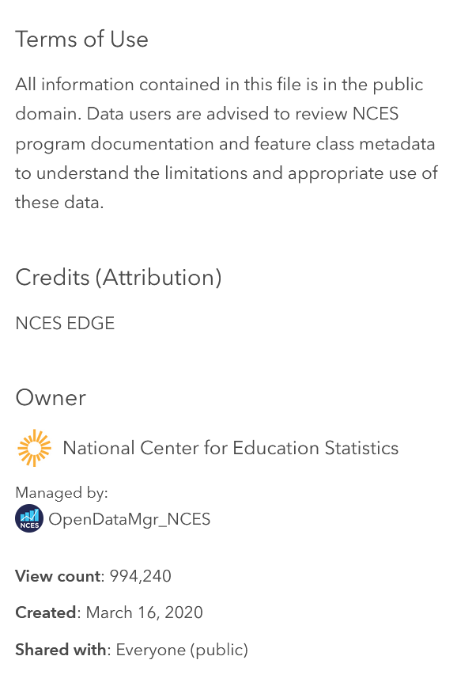
Reading Layers and giving credit
Title
Updated
Description
Terms of Use
Credits (Attribution)
Owner
Managed by
View Count
Created
Shared with

Slide 18
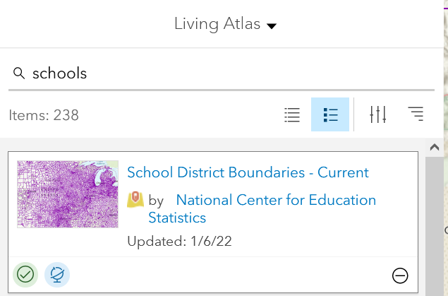
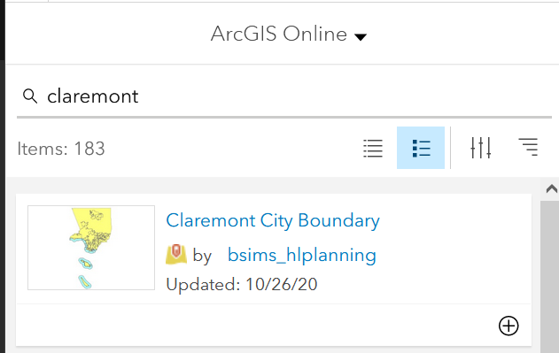
Libraries

Slide 19
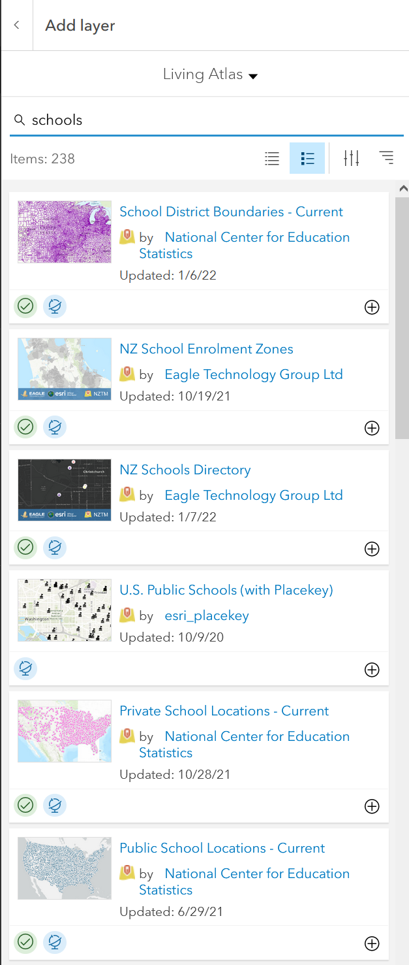


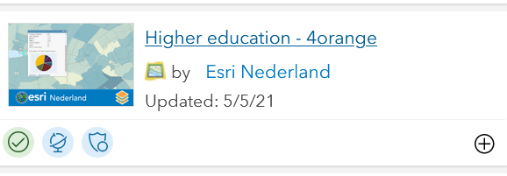
All fun and games till you run out of Credits!!!
Credits vs. Free
Story time! (every GIS specialist has one) The time I blew all my credits on converting all addresses from regular mail to address to geocodes
Addresses vs. Geocodes
latitude versus longitude

Slide 20
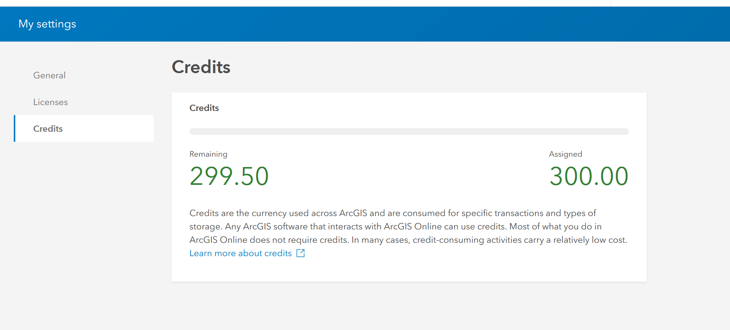
Credits Talk

Slide 21
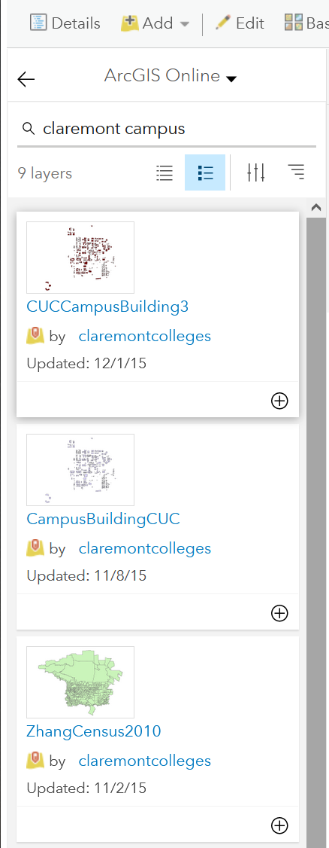
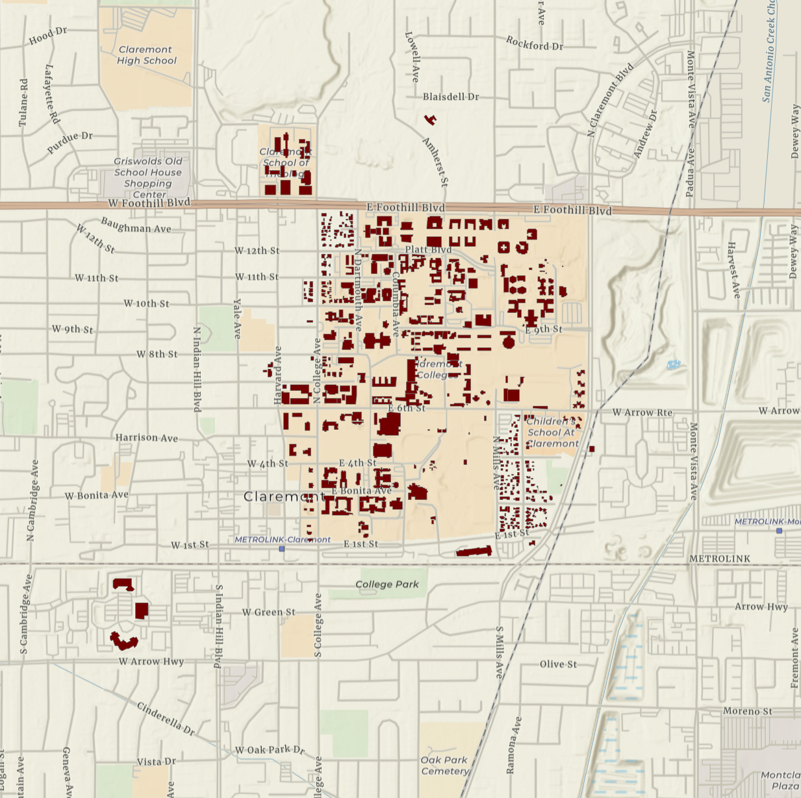
Claremont Campus

Slide 22
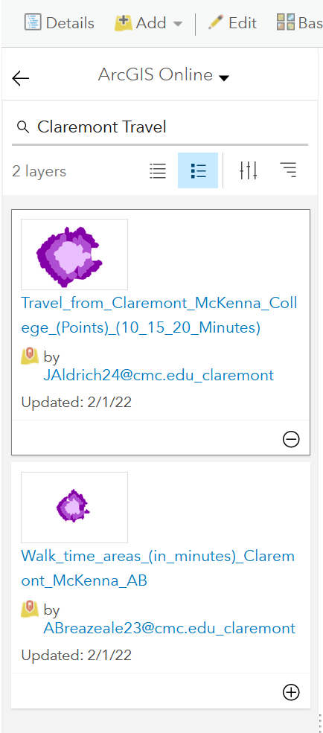
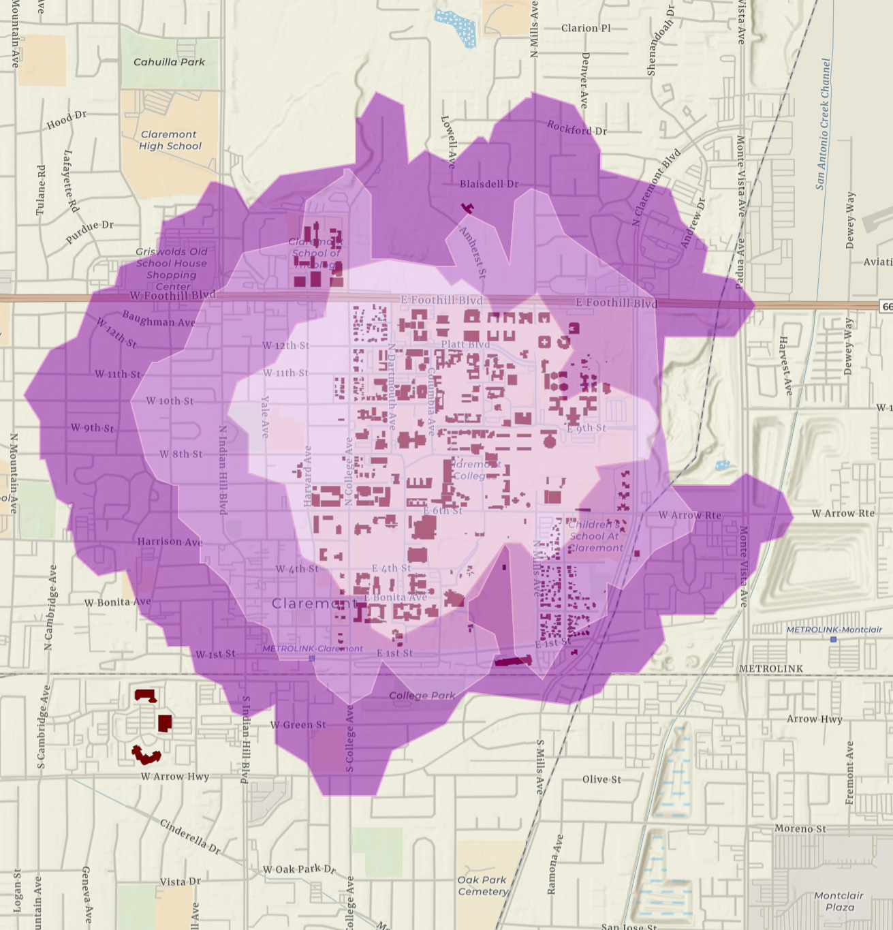
Claremont Travel Distance

Slide 23
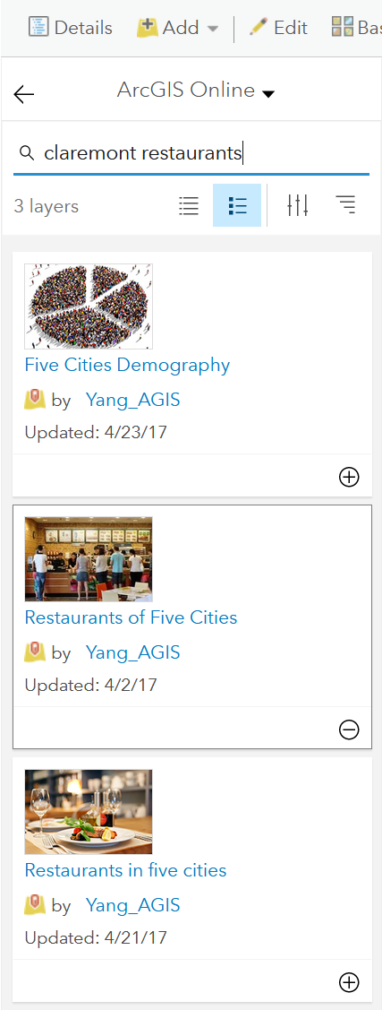
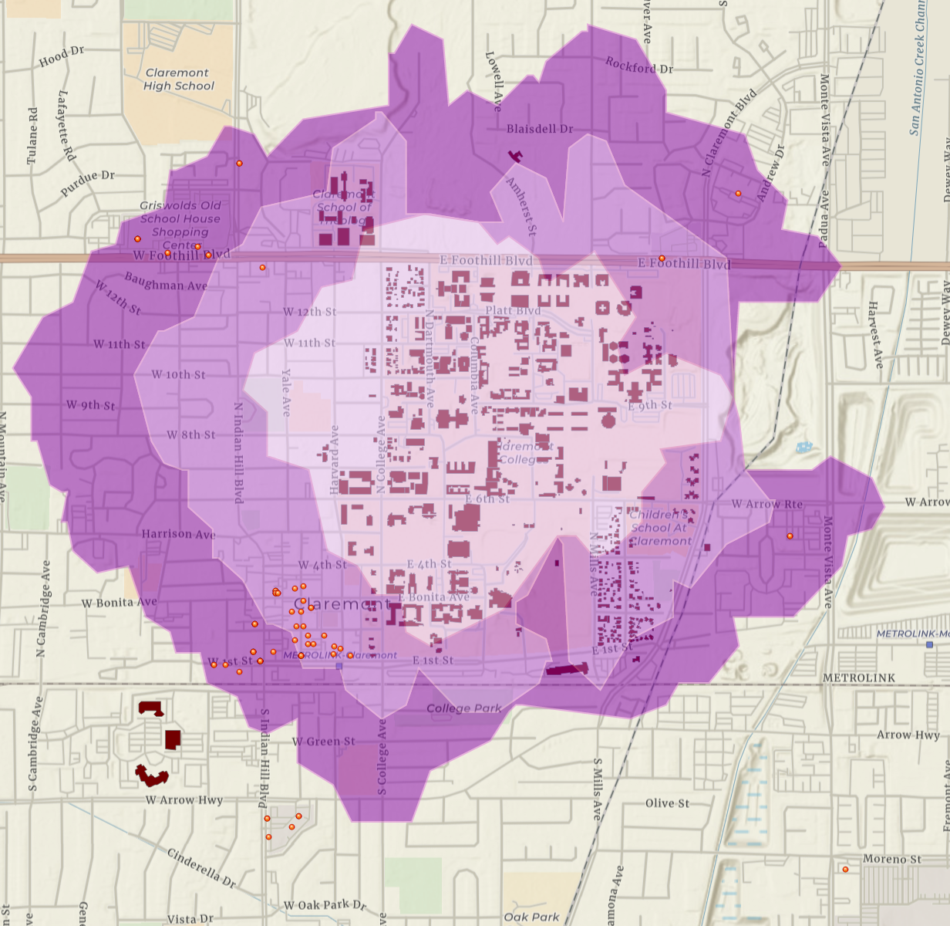
Claremont Restaurants

Slide 24
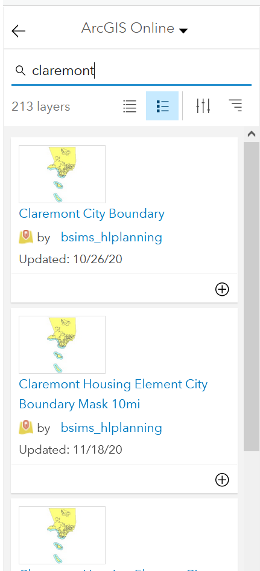
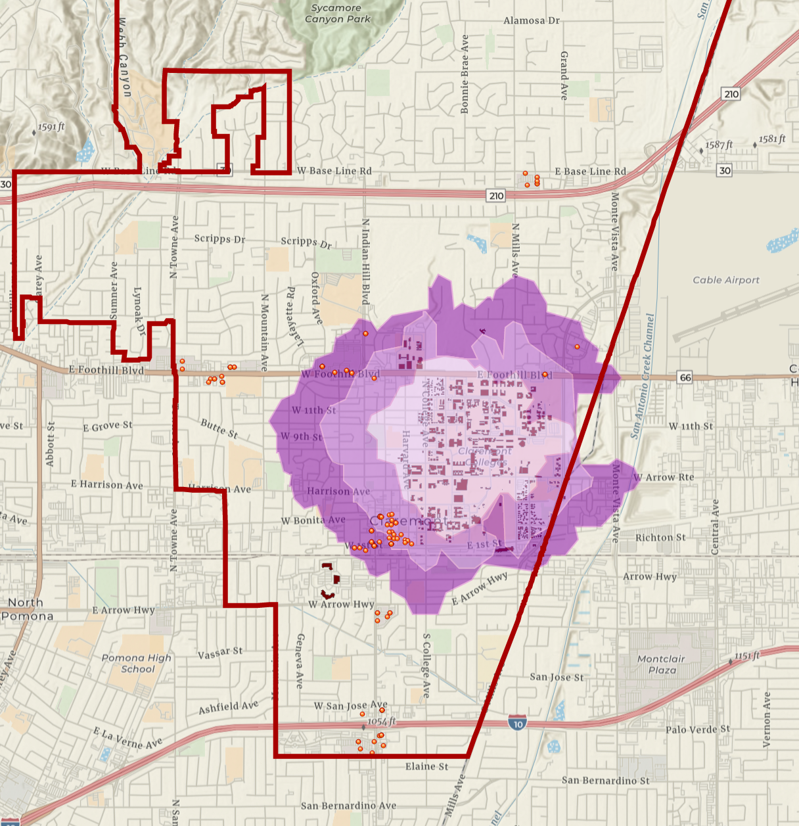
Claremont City Boundary

Slide 25
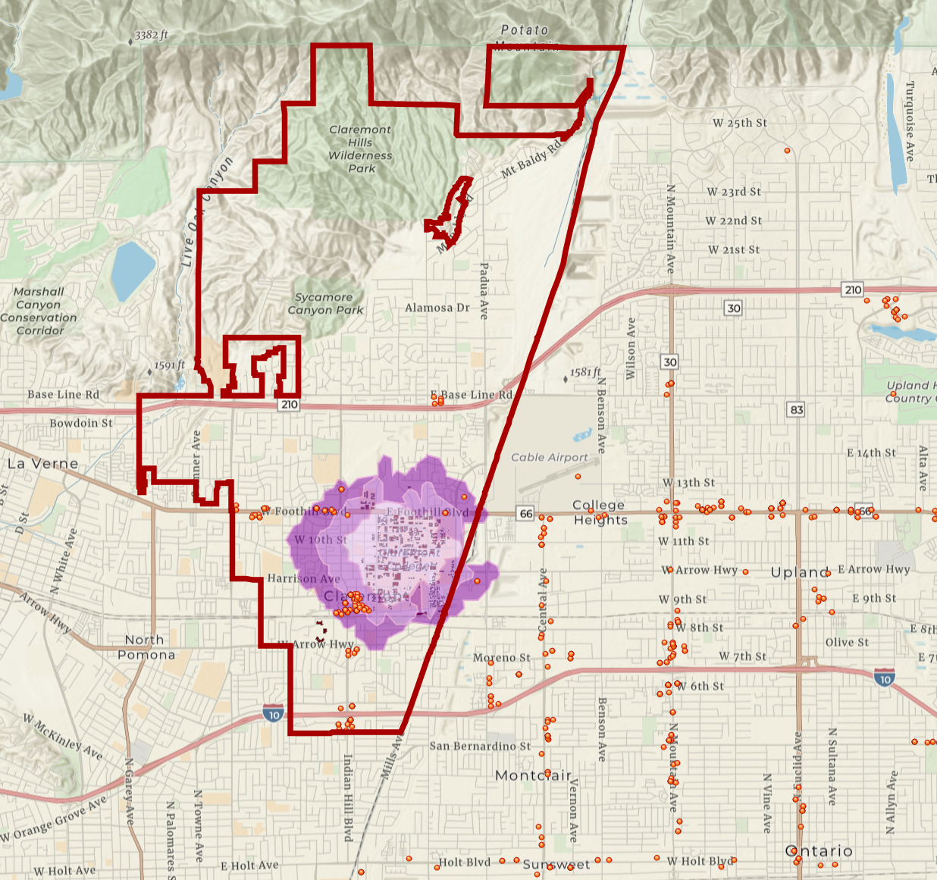
So much information – it hurts my eyes!

Slide 26
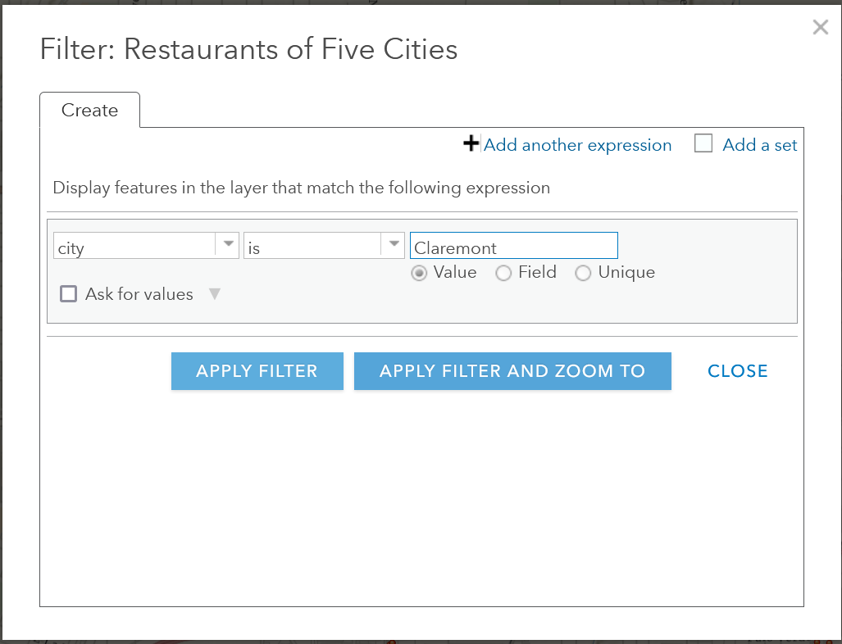

Filter

Slide 27
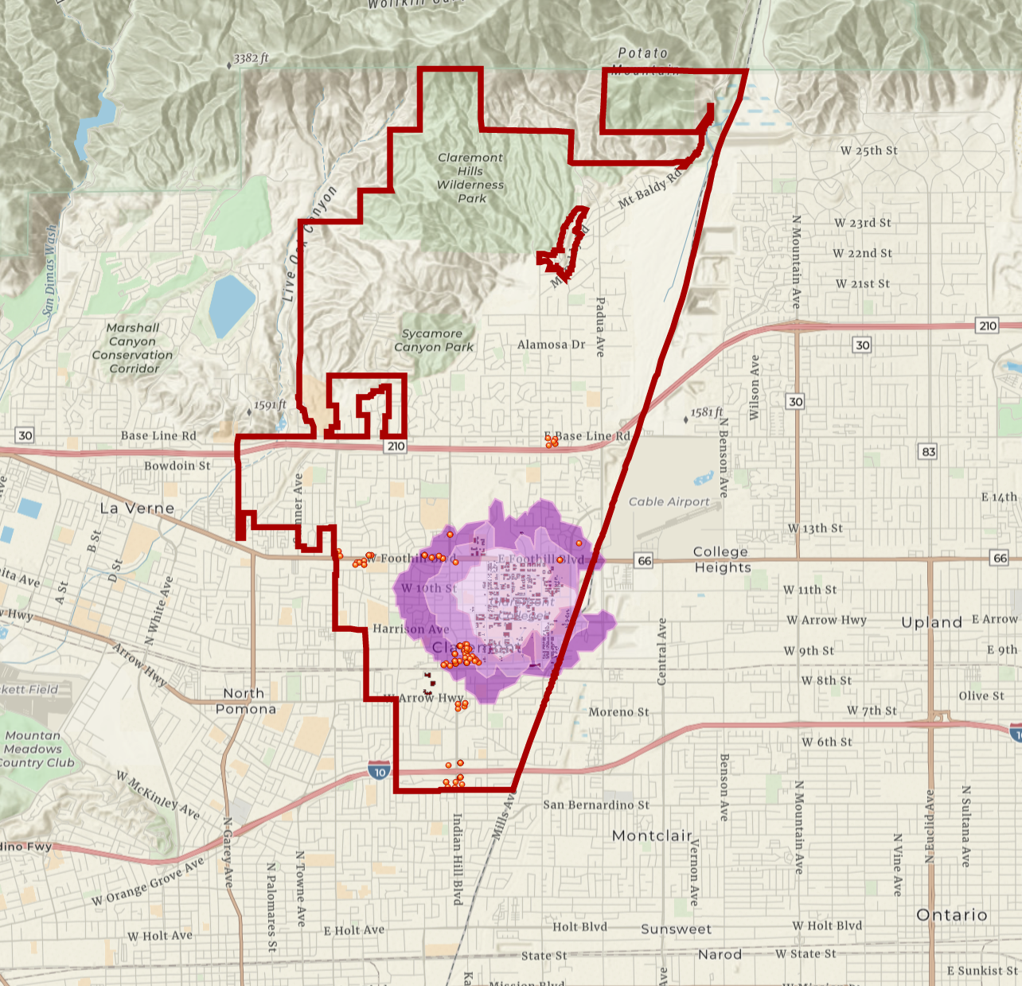
Result

Slide 28
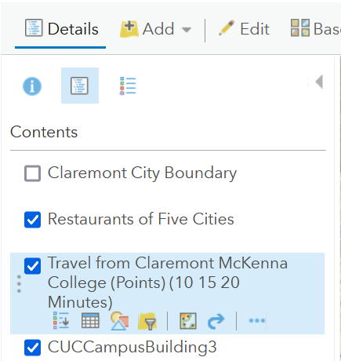
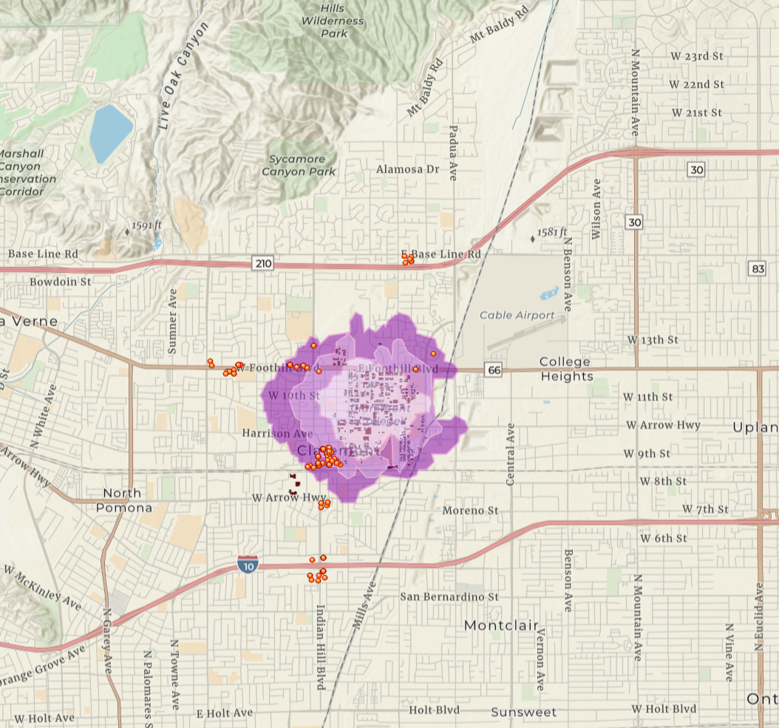
Uncheck Claremont City Boundary

Slide 29

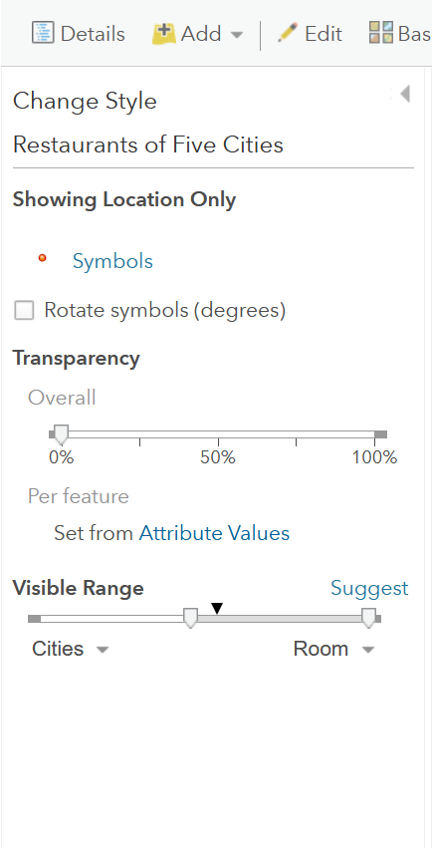
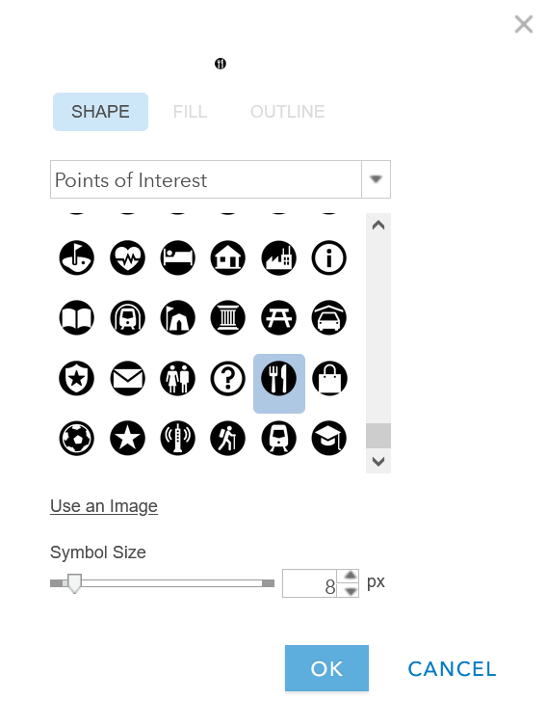
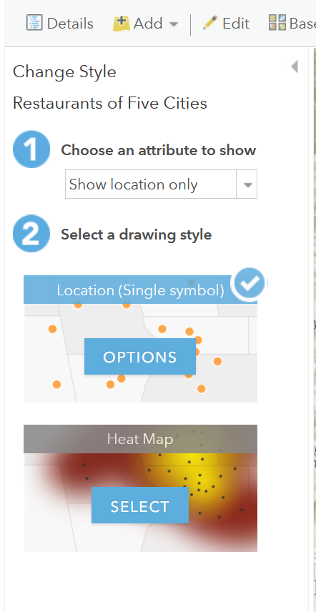
Point Icons

Slide 30
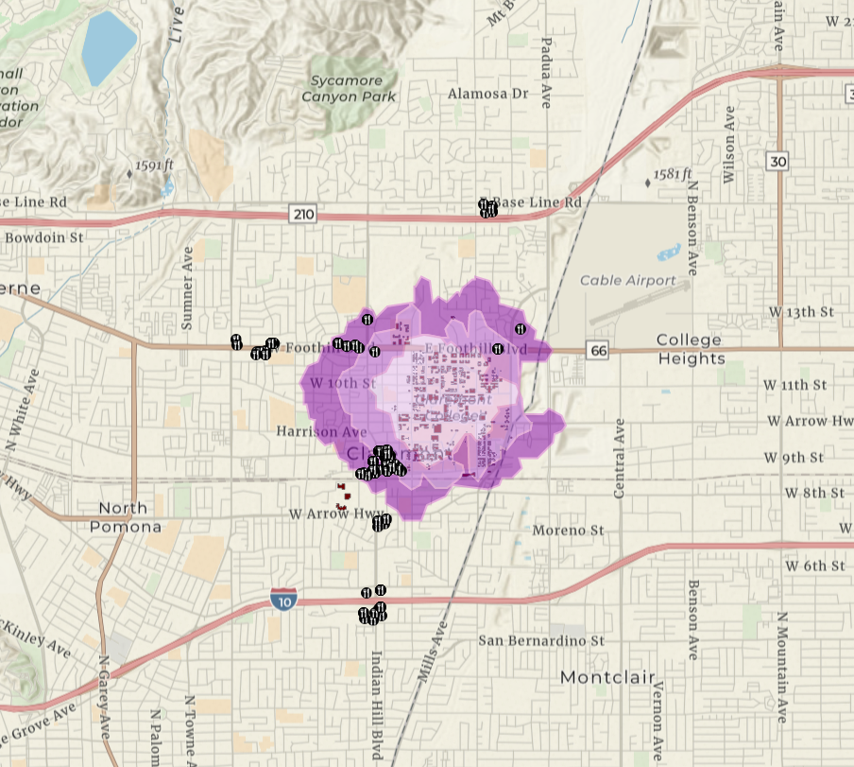
Result

Slide 31

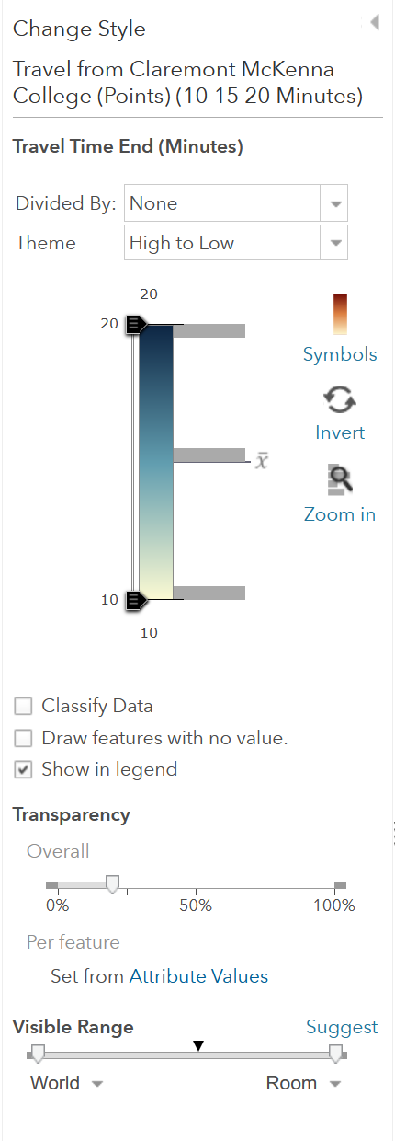
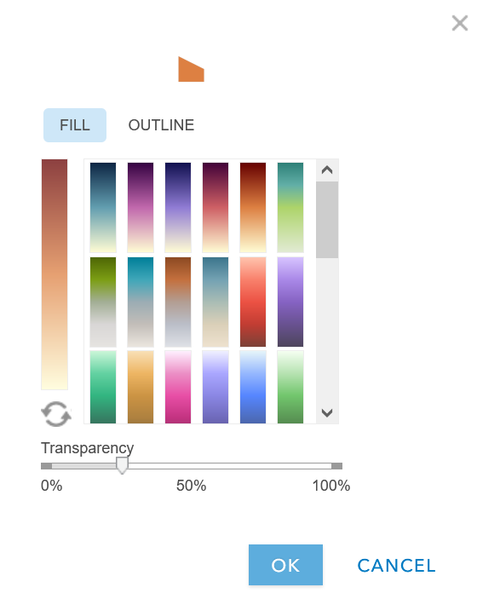
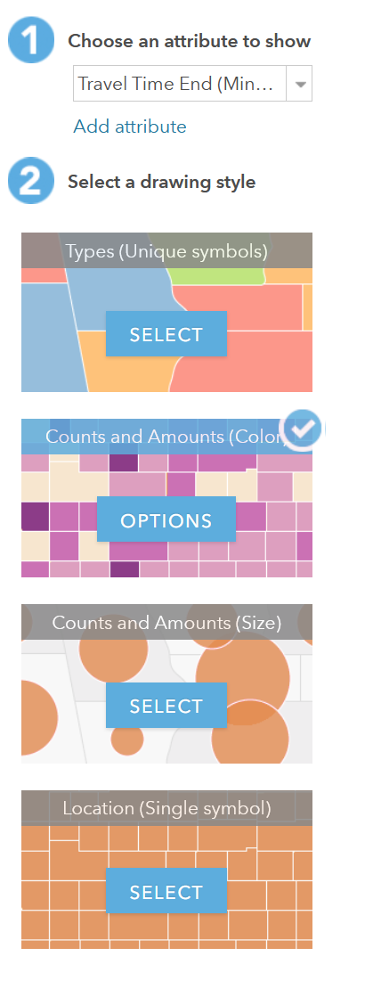
Traveling around Claremont

Slide 32
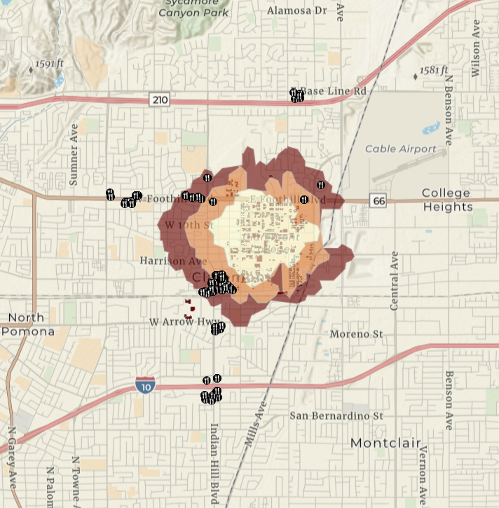
Result

Slide 33
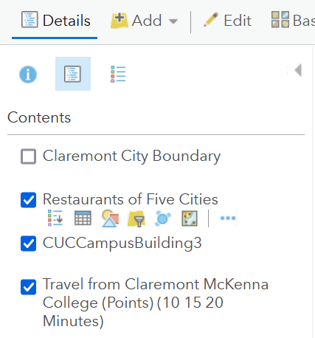
Move Layers Around

Slide 34

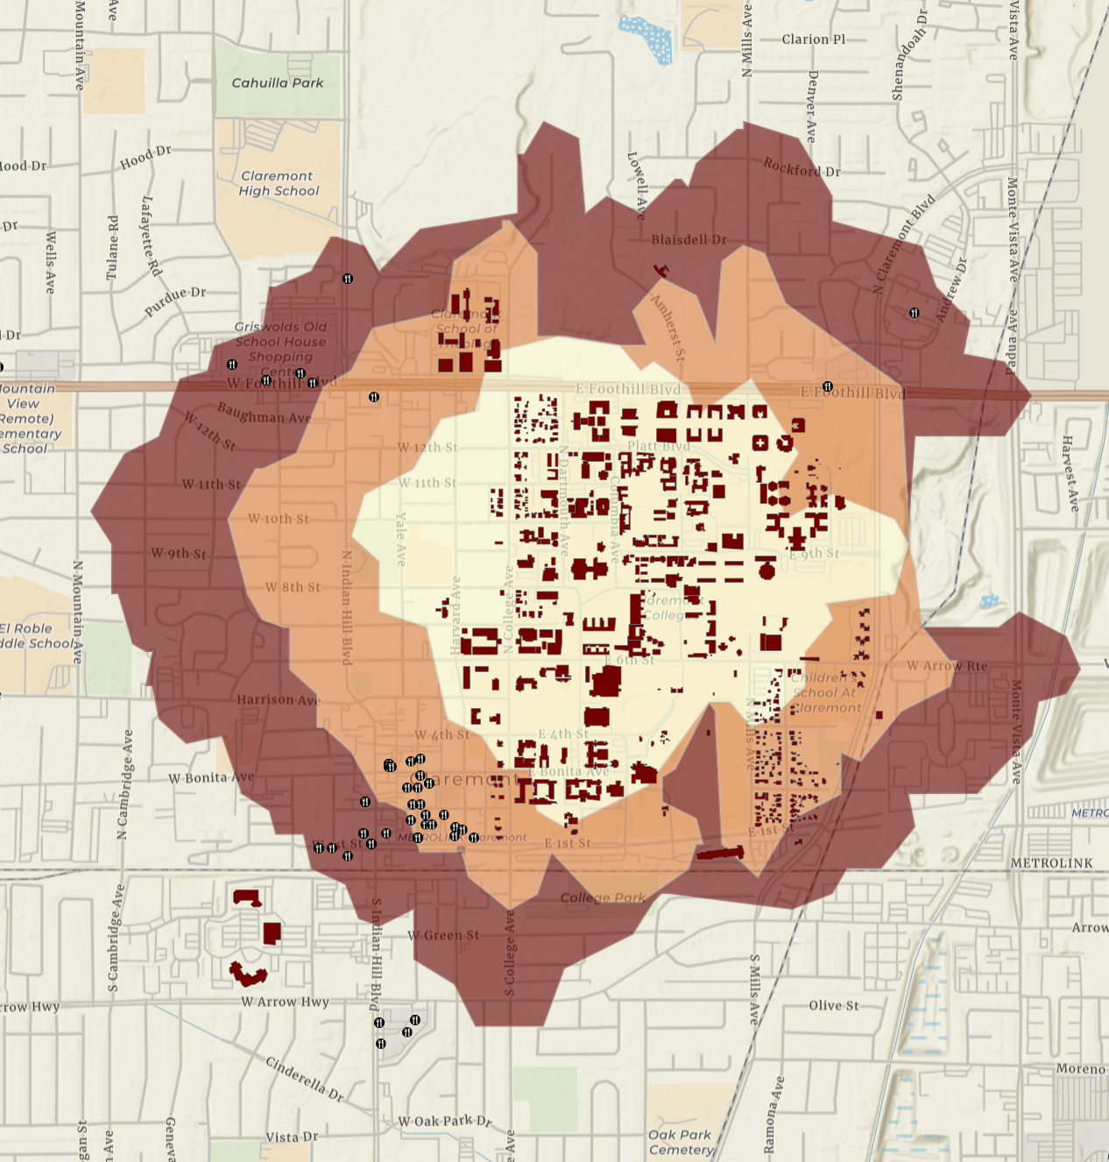
A better visual story

Slide 35
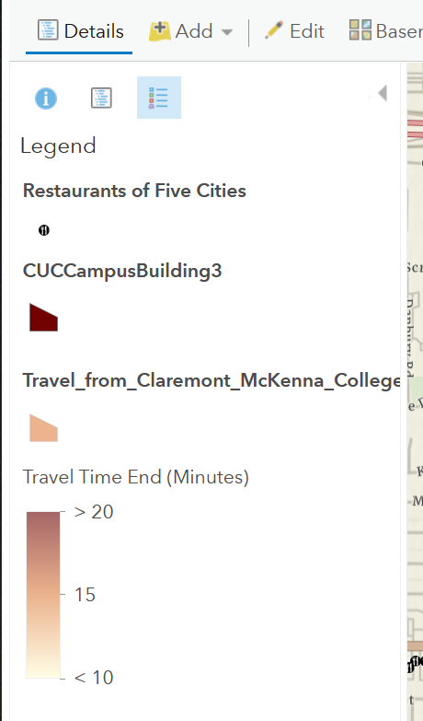
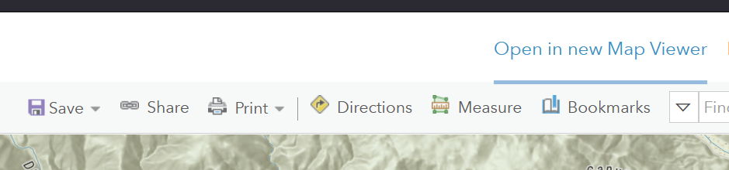
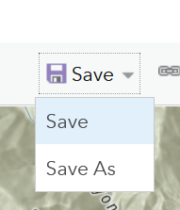
Legend and Save

Slide 36
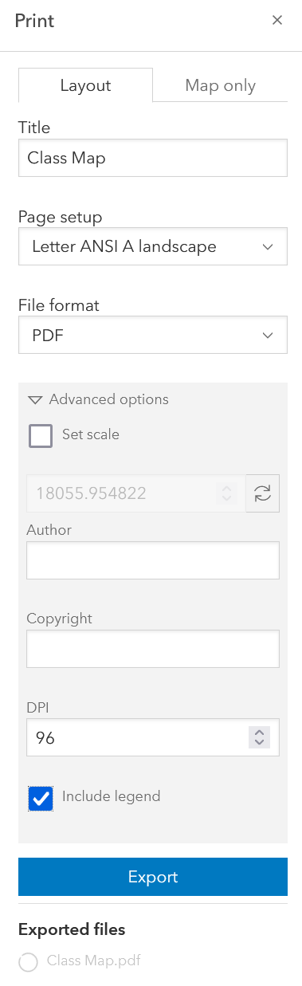
Printing a Map

Slide 37


Slide 38

Edit your Layers Information
Title
Updated
Description
Terms of Use
Credits (Attribution)
Owner
Managed by
View Count
Created
Shared with

Slide 39

QCL Workshops
https://www.cmc.edu/qcl/workshops

Slide 40
Resources
ERSI: https://www.esri.com/en-us/home
ArcGIS: https://learn-arcgis-learngis.hub.arcgis.com/

Slide 41
Contact
QCL: QCL@cmc.edu
Vanessa: vanessa.casillas@claremontmckenna.edu

